Slide 1
Co-located Multi-user VR System We Are Headset
Technical feasibility validation of a 3-user Meta Quest 3 co-located setup
20/01/26 Kasper Vork · Jon Friis · Sebastian Jensen · Sebastian Pedersen · Seb J

Slide 2
Agenda
1. The Case
2. Video Presentation
3. State of the Art
4. Research (Approach & Benchmarks)
5. Prototype
6. Results
Slides mapped to your outline: 03–08

Slide 3
The Case
Jon
Challenge: enable co-located multi-user VR training on consumer hardware (Meta Quest 3) without external tracking.
Safety: maintain sub-centimeter spatial alignment to reduce collision risk (reference target <10mm).
Collaboration: keep network latency low on consumer WiFi (target ≤ 75ms RTT).
Stability: sustain 72Hz rendering over long sessions without thermal throttling or drift.
Practicality: minimal setup time + repeatable multi-headset deployment workflow.

Slide 4
Video Presentation
Seb P.
Insert demo video (or link/QR) here:
- Co-location join flow (host advertises group UUID; guests discover & localize anchor)
- Shared arena alignment across 3 headsets
- Drone shooting gameplay + avatars (Fusion sync)
- On-device logging overlay (latency/fps/thermal)

Slide 5
State of the Art
Sebastian Holmsted
Latency & QoE: good collaboration typically needs ≤ 75ms RTT; >300ms degrades severely (Van Damme et al.).
Co-location calibration: SLAM-tracked headsets can reach ~10mm with suitable procedures (Reimer et al.).
Spatial awareness: WIM / map-style overviews improve coordination in complex tasks (Chen et al.).
Cross-user consistency: mismatched representations reduce performance and experience (Weiss et al.).
Gap: limited validation that a consumer 3-user standalone setup can meet alignment + latency + stability simultaneously.

Slide 6
Research
Kasper Vork
Goal: technical feasibility validation (not a learning-outcome study).
RQ1–RQ5 cover: colocation implementation, accuracy/drift, on-device monitoring, deployment workflow, feasibility boundaries.
Benchmarks (literature-derived): ≤ 75ms RTT; <10mm alignment; ~72Hz frame rate; sustained stability over 60–90 min.
Method: 3 headsets, local WiFi, continuous 1Hz on-device logs (CSV + JSON metadata).
Limitation: drift measured under stationary baseline; motion-robustness treated as future work.

Slide 7
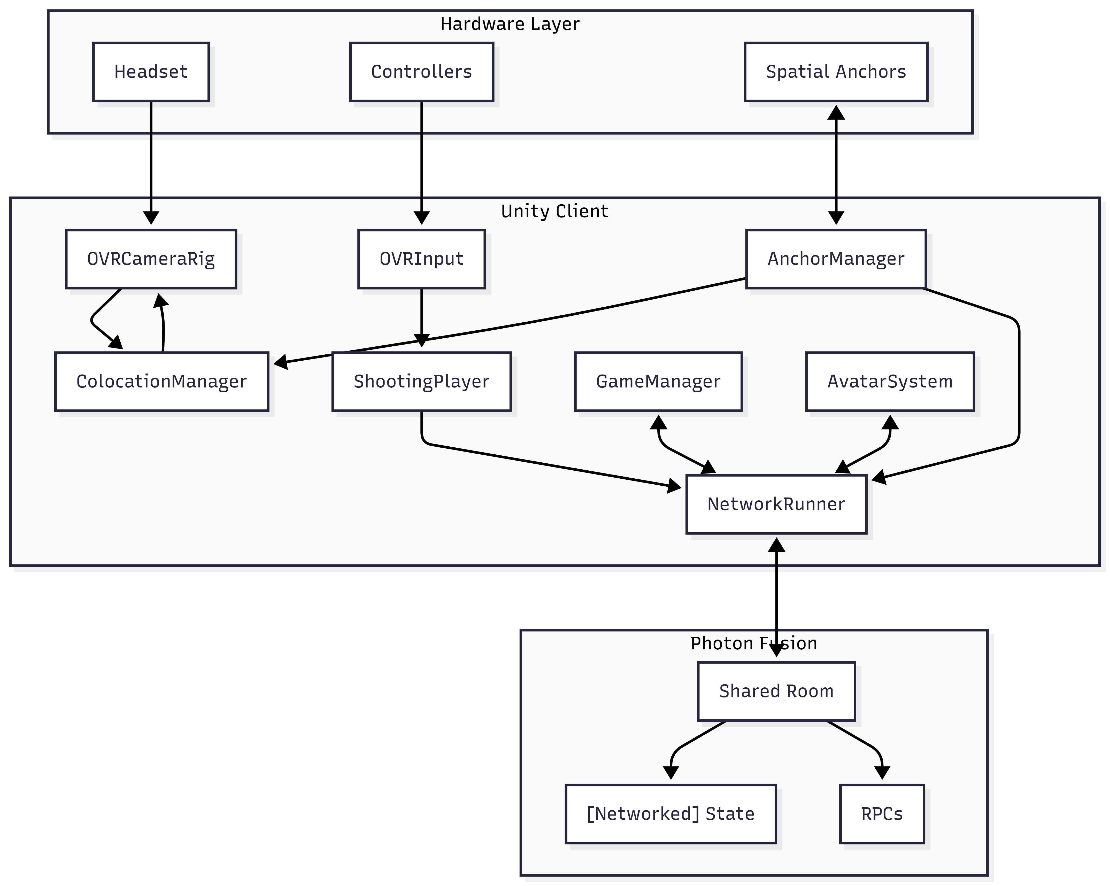
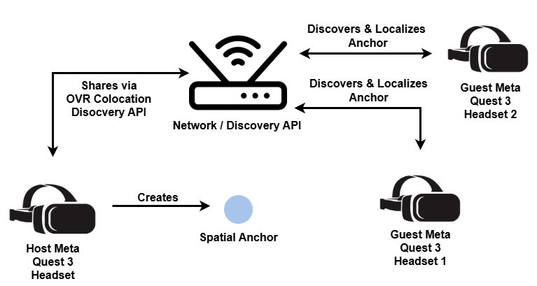
Prototype
Jon Friis & Seb P
Hardware: 3× Meta Quest 3, co-located in shared physical space; dedicated 5GHz WiFi channel.
Unity: 6000.0.62f1 + URP.
Co-location: OVR Colocation Discovery + Shared Spatial Anchors (host creates anchor; guests localize & align rig).
Networking: Photon Fusion 2 for shared objects, avatars, and gameplay sync.
Instrumentation: on-device logging at 1Hz for RTT, fps, calibration error, and thermals.

Slide 8
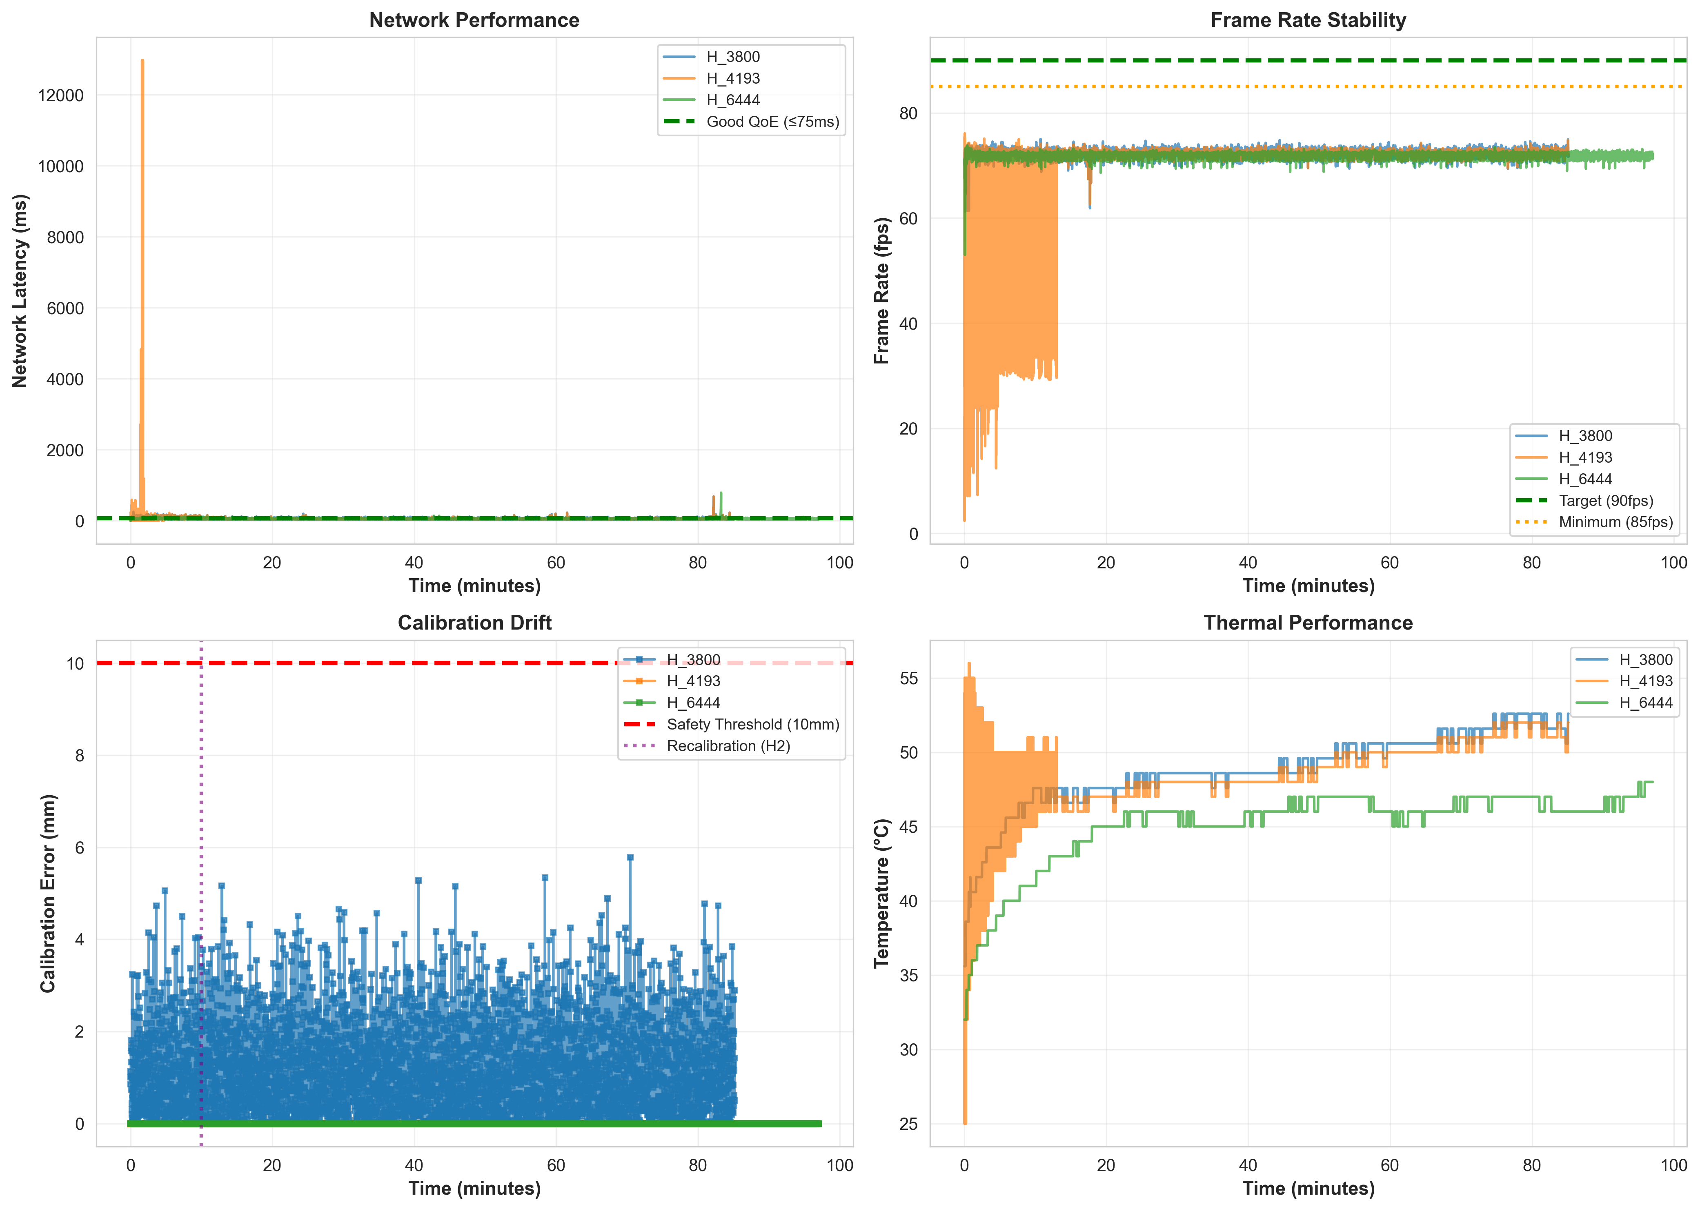
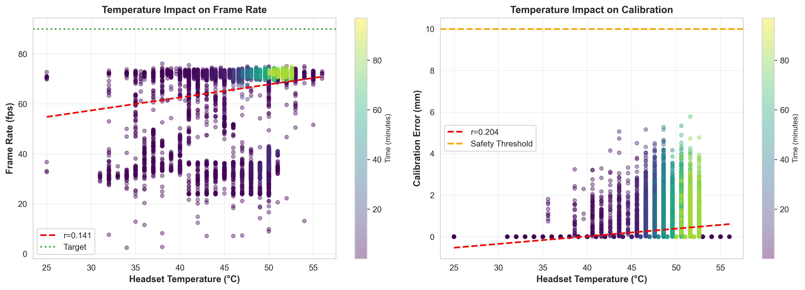
Results
Jon Friis & Seb P
Longest 3-headset continuous window: 85.1 min (5073 samples/headset @ 1Hz; 15,234 total).
Network RTT: mean 58.2 ± 21.3ms; P95 86.0ms (tail occasionally exceeds 75ms target; spikes during init/sync).
Calibration error (stationary baseline): mean 1.21 ± 0.90mm; max 5.78mm (well below 10mm reference).
Frame rate: 72.2 ± 0.7 fps around 72Hz target.
Thermals: warming observed (max 52.6°C) while performance remained stable.

